Slide 1

ICEG
REVIEW COMITE
08/11/2024

Slide 2
Welcome & agenda of the meeting

Slide 3
[Draft] AGENDA
TOPIC | SPEAKER | TIMING
Welcome and agenda |  | 14u00 – 14u05
ICEG IMKL – recognition implementation model | Eveline Vlassenroot | 14u05 – 14u15
ICEG Person – status | Mathieu Tulpinck / Liesbet D'Hondt | 14u15 – 14u25
BEST: status assessment | Eddy Corthouts | 14u25 – 14u35
Status ICEG agreement 2024-2025 | Review Meeting | 14u35 – 14u45
Interoperable Europe Act: approach Belgif publications | Eveline Vlassenroot / Bert Van Nuffelen
Other?

Slide 4
ICEG IMKL: Recognition Implementation Model

Slide 5
Recognition IMKL Implementation Model
IMKL is in use in the KLIP since 2016.
The current version IMKL 2.3 has received an update in 2023-2024.
Today developments in the KLIP-team are starting in order to make IMKL 3 available for users of the KLIP system.
For the use of KLIP and IMKL there is a legal obligation, laid down in the KLIP decree.
Statement of the most actual version of IMKL, needs to be laid down in a ministrial decision.
IMKL Semantic datamodel received official ICEG-recognition on the ICEG Management Committee of 25/09/2024
Process and result have been approved
Semantic datamodel has been published on Vocab-website
Consequetively, IMKL implementation model:
has been developped and published on Vocab (codelists + XSD-schema)
Question for the ICEG committee:
Can we implicitely assume that – since the semantic model has been run through the ICEG process – the implemetation model is also officially recognized within the ICEG Governance?

Slide 6
ICEG Person - Status

Slide 7
ICEG Assessment BEST - Status

Slide 8
ICEG Agreement 2024-2025 - Status

Slide 9
Interoperable Europe Act (topic from ICEG Management Meeting 25/09/2024)

Slide 10
Interoperable Europe Act
ICEG 25-09-2024

Slide 11

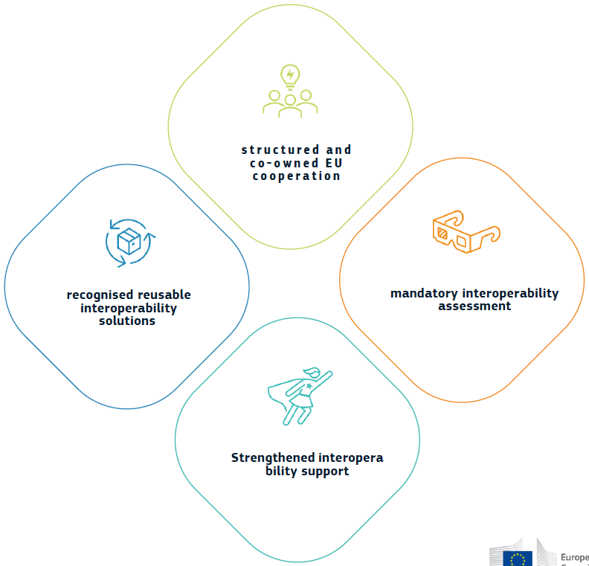
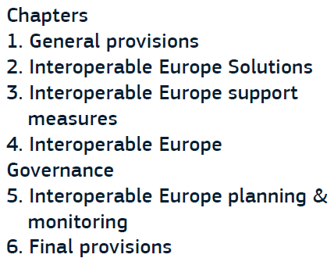
Key pillars

Slide 12
Interoperability assessment
Art 3: verplichte assessment
- voor bindende beslissingen die invloed hebben op interoperabiliteit van cross-border systemen
- gebaseerd op EIF
- rapport verplicht in machine-readable format op officiële website en verplicht in te dienen bij Board
- zaken die al afgedekt zijn door EU impact assessment moeten niet opnieuw geassessed worden op nationaal niveau
- Board voorziet ondersteunende guidelines/hulpmiddelen voor uitvoering van assessments

Slide 13
Interoperability support
Art 9: support projects
Art10: innovation measures
Art 11+12: interoperability regulatory sandboxes (min 3 participants)
Art 13: training: board provides free training material & online training programmes, EU&MS provide training programmes for staff
Art 14: peer reviews (voluntary, by experts from other MS)

Slide 14
National Competent Authority & SPOC (Art 17)
Meerdere NCA’s mogelijk, maar 1 enkele SPOC NCA per MS
Taken SPOC:
coördinatie NCA’s + afstemming met EU & andere lidstaten
Taken NCA’s:
- ondersteuning interoperability assessments
- coördinatie & promotie deelname aan support measures
- stimulatie reuse via portal(s)
administraties ondersteunen bij samenwerking met administraties van andere lidstaten
Awareness & training activiteiten op vlak van interoperabiliteit
MS moeten voldoende competente ressources voorzien.

Slide 15
Timing (tov entry into force: 11/04/2024)
3M (11/07/2024): IEA becomes applicable
9M (11/01/2025):
Verplichte impact assessments + guidelines (COMM)
NCA’s aanduiden + SPOC communiceren aan COMM
Verplichte share & reuse (art 4) + guidelines
12M (11/04/2025): implementing acts regulatory sandboxes
45M : 4-jaarlijks rapport door Commissie

Slide 16
Aanpak op nationaal niveau?
NCA’s: momenteel: BOSA (SPOC) + Vlaanderen + Brussel(?)
=> streven naar 1 NCA per regio, of misschien zelfs naar 1 NCA per dienstenintegrator?
Coördinatie: via ICEG?
=> zo ja, zorgen dat de juiste mensen aan de ICEG deelnemen!
=> daarnaast afstemming via mail ter voorbereiding van EU Interoperable board meetings?
Belgif portaal: heeft grondige update nodig (vb met uitleg over IEA, NCA’s, interoperability assessments, …)
=> welke info willen de NCA’s/regio’s erin opnemen (vb eventuele doorverwijzing naar regionale portalen?)
=> opm: wat doen we met reusable solutions in BE ? Ook op Belgif? Of op portaal van ICT- Reuse? EU Comm vraagt immers integratie/synchronisatie met Interoperable Europe Portal
Publicatie impact assessments: op website instelling of centraliseren (vb op Belgif portaal)?
Inplannen van communicatie campagne om awareness op vlak van IEA te verhogen?

Slide 17
QUESTIONS?
nicolas.vervaeck@bosa.fgov.be

Slide 18
Belgif publications * Publication process * User experience

Slide 19
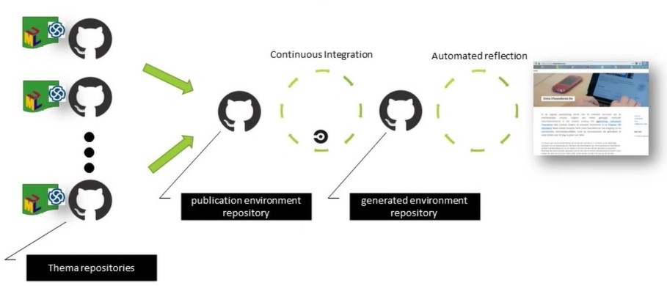
Publication process (data.vlaanderen.be)
Change request:
through “pull request”
→ Manual approval
Automatic push
towards frontend
Publication (UI)
GitHub = backend
→ Manual updates

Slide 20
Publication process (vocab.belgif.be)
Question:
In order to reduce
human/technical
bottlenecks: could we go
towards automatisation
of this step in the process?
Change request:
through “pull request”
→ Manual approval
Manual push
towards frontend
Publication (UI)
GitHub = backend
→ Manual updates

Slide 21
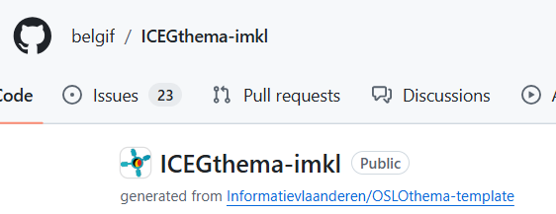
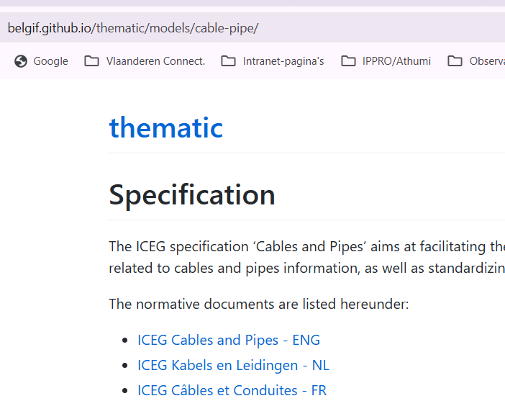
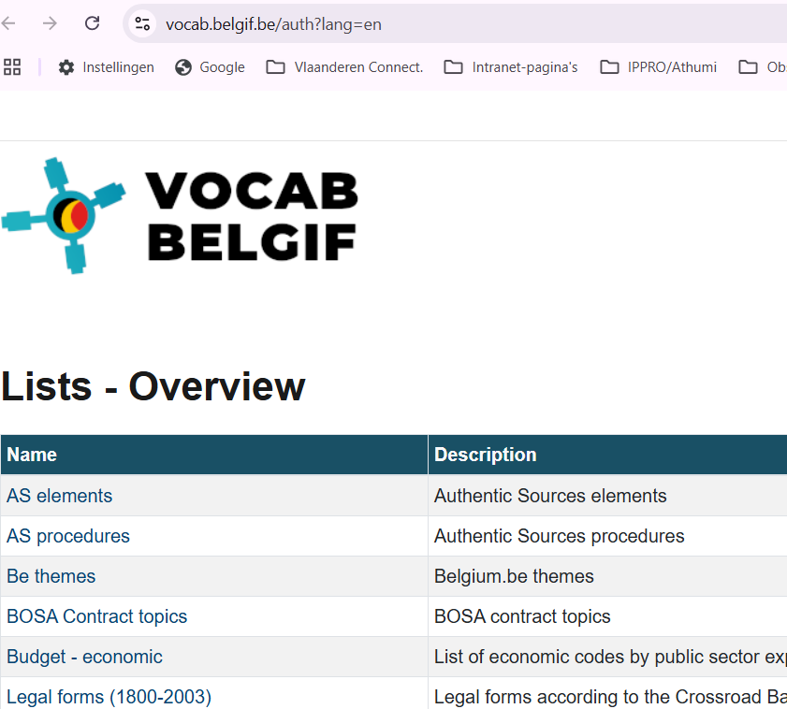
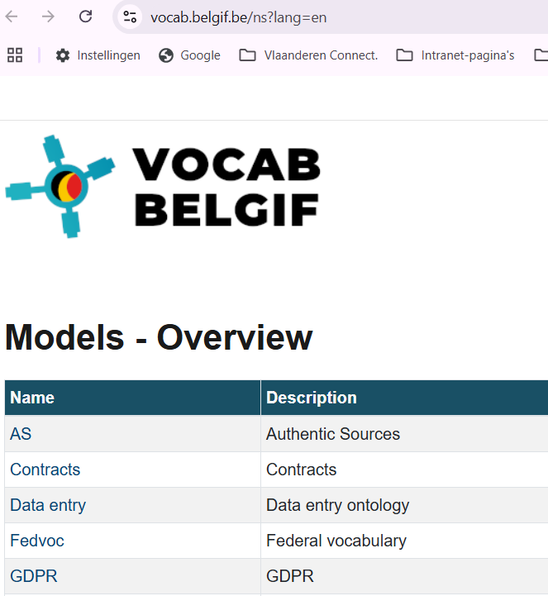
User experience (use case IMKL)
Backend (GitHub)
3 UI’s
Online Specification
(semantic model)
Codelists
(implementation model)
XSD-scheme
(implementation model)

Slide 22
Question for the ICEG Review Commitee
Based on best practices OSLO tools & methods, can we prospect for Belgif, the possible investment on:
Automatisation of the backend process towards online publication? (prio)
Improving user experience on the UI?

Slide 23
Other topics?

Slide 24
Next ICEG Meeting:
Date: 12 December 2024
Time: 14:00-16:00
Location: Physically? Or via MS Teams?
Meetings 2025
!Action: Schedule upcoming meetings
Discuss preferred dates
Define frequency
Confirm locations

Slide 25

Thank you for your attention
Any questions?
Notes:
Verschillende opties als tussenslide

